Slide 1



Consumer Goods Ad_Hoc Insights
Power BI Desktop

Slide 2
Introduction
Power BI Desktop
Domain: Consumer Goods | Function: Executive Management
Atliq Hardwares (imaginary company) is one of the leading computer hardware producers in India and well expanded in other countries too.
However, the management noticed that they do not get enough insights to make quick and smart data-informed decisions. They want to expand their data analytics team by adding several junior data analysts. Tony Sharma, their data analytics director wanted to hire someone who is good at both tech and soft skills. Hence, he decided to conduct a SQL challenge which will help him understand both the skills.

Slide 3

List of markets in which customer "Atliq Exclusive" operates its business in the APAC region
Power BI Desktop
market
Australia
Bangladesh
India
Indonesia
Japan
Newzealand
Philiphines
South Korea
select distinct market from dim_customer
where customer = "Atliq Exclusive " and region ="APAC"

Slide 4

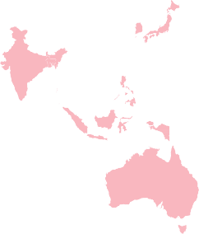

Conversion from Output to Visuals
Power BI Desktop
market

Australia
Bangladesh India Indonesia Japan Newzealand Philiphines South Korea
© 2024 Miiccrrossofftt Corrporrattiion
Key Insights
Atliq Exclusive has a diversified presence across the APAC region, catering to a wide range of customer needs and preferences.
The focus on developed economies (Japan, Australia) alongside emerging markets (Indonesia, Bangladesh) indicates a strategic approach to market expansion.
This geographic spread suggests Atliq Exclusive is well-positioned to capitalize on the growing demand for computer hardware in the dynamic APAC region.

Slide 5
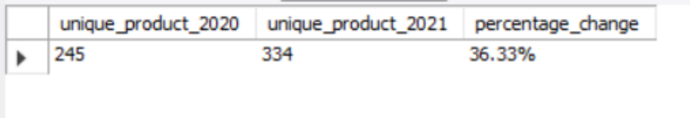
Percentage of unique product increase in 2021 vs. 2020
Power BI Desktop
with unique_product_count as ( select count(distinct
case when fiscal_year = 2020 then product_code end) as
unique_product_2020,
count(distinct case when fiscal_year = 2021 then product_code end) as unique_product_2021
from fact_sales_monthly
)
select unique_product_2020, unique_product_2021,concat(round(((unique_product_2021- unique_product_2020)*1.0 / unique_product_2020)*100,2),'%') as percentage_change
from unique_product_count

Slide 6

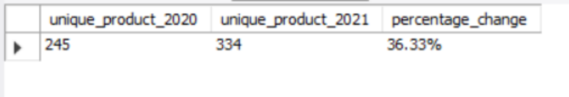
Conversion from Output to Visuals
Power BI Desktop
Unique Products By Year
334
245
year
2020 2021
Key Insights on Unique Product Increase (2021 vs. 2020)
The data shows a significant increase of 36.33% in unique products offered by Atliq Hardware in 2021 compared to 2020. This suggests a strategic move by the company to expand its product portfolio.
Here are some potential reasons and insights:
Market Expansion: Atliq Hardware might be venturing into new product categories beyond its core business of computer hardware. This could be a response to emerging market trends or customer demands for complementary products.
Product Innovation: The increase could indicate the introduction of new variations or upgrades to existing product lines. This strategy helps attract new customers and retain existing ones by offering a wider range of choices and improved functionalities.
Competitive Landscape: It's possible that Atliq Hardware is reacting to its competitors' offerings. By introducing new products, they can stay relevant and maintain their market share.

Slide 7
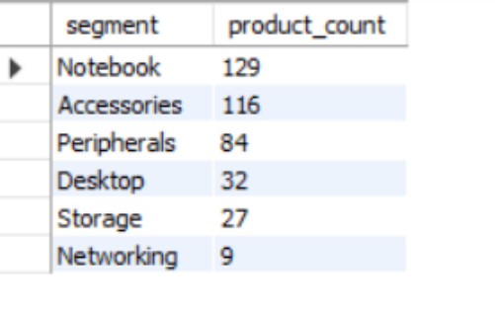
Unique product counts for each segment
Power BI Desktop
select segment, count(distinct product_code) as product_count
from dim_product
group by segment
order by product_count desc

Slide 8
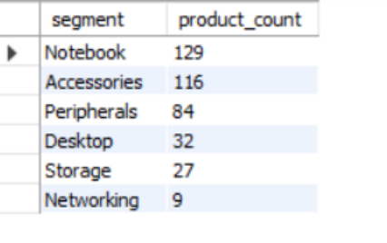
Conversion from Output to Visuals
Power BI Desktop
Products by Segment
129
116
84
32
27
9
Notebook
Accessories
Peripherals
Desktop
Storage
Networking
Key Insights
The analysis reveals that Atliq Hardwares has a strong emphasis on offering a diverse range of products, with notebooks and accessories being the most prominent segments. This indicates a strategic focus on catering to various consumer needs and preferences in the computer hardware market.
The high product counts in segments like notebooks and accessories suggest significant consumer demand for portable computing solutions and complementary peripherals. This insight can guide product development and marketing efforts to capitalize on popular product categories and meet evolving consumer preferences.
While segments like desktops, storage, and networking have lower product counts compared to notebooks and accessories, they still represent potential areas for growth and diversification. By identifying and addressing gaps in product offerings within these segments, Atliq Hardwares can further expand its market presence and capture additional market share in the computer hardware industry.

Slide 9
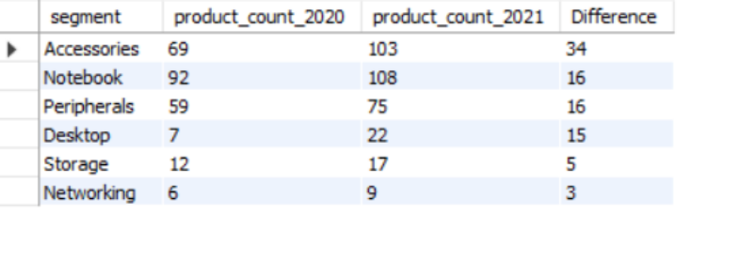
Segment had the most increase in unique products in 2021 vs 2020
Power BI Desktop
with unique_product as ( select
p.segment as segment,
count(distinct (case
when fiscal_year = 2020 then f.product_code end)) as
product_count_2020, count(distinct
(case
when fiscal_year = 2021 then f.product_code end)) as product_count_2021
from
fact_sales_monthly as f inner join dim_product as p
on p.product_code = f.product_code
group by p.segment
)
select segment, product_count_2020, product_count_2021,
(product_count_2021- product_count_2020) as Difference
from unique_product order by Difference desc

Slide 10
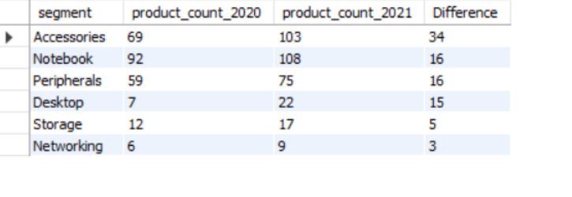
Conversion from Output to Visuals
Power BI Desktop
Products by Segment in 2020 and 2021
103
108
92
69
75
59
22
17
7
12
6
9
Accessories
Notebook
Peripherals
Desktop
Storage
Networking
Key Insights
The segment with the most substantial increase in unique products between 2020 and 2021 is Accessories, indicating a strategic focus on expanding accessory offerings to complement core hardware products.
Notebook and Peripherals Remain Strong: While Accessories saw the highest increase, it's essential to note that Notebook and Peripherals segments also experienced considerable growth, suggesting continued investment in core product categories to meet evolving consumer demands.
Desktop Surges: The Desktop segment showed a significant surge in unique products, indicating potential market opportunities or shifts in consumer preferences towards desktop computing solutions.

Slide 11
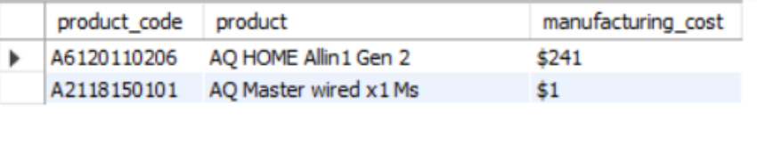
Products that have the highest and lowest manufacturing costs
Power BI Desktop
select d.product_code as product_code, d.product as product,
concat('$', round(m.manufacturing_cost)) as
manufacturing_cost from dim_product as d
inner join fact_manufacturing_cost as m
on d.product_code = m.product_code where m.manufacturing_cost = (select max(manufacturing_cost) from fact_manufacturing_cost)
or m.manufacturing_cost = (select
min(manufacturing_cost) from fact_manufacturing_cost) order by m.manufacturing_cost desc

Slide 12
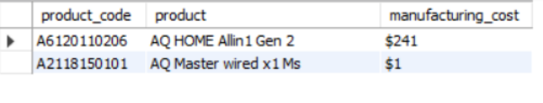
Conversion from Output to Visuals
Power BI Desktop
Product having Highest and Lowest Manufacturing Cost
$241
$1
AQ HOME Allin1 Gen 2
AQ Master wired x1 Ms
Key Insights
The analysis reveals a significant disparity in manufacturing costs between the highest and lowest-priced products. While the AQ HOME Allin1 Gen 2 incurs a manufacturing cost of $241, the AQ Master wired x1 Ms has a notably lower cost of $1. This wide range underscores the importance of cost optimization strategies and pricing considerations in product development and marketing decisions.
Products with advanced features or intricate designs are likely to incur higher manufacturing costs due to the use of premium materials or sophisticated manufacturing processes.
The cost of raw materials and components directly impacts manufacturing costs. Products requiring expensive or specialized materials will have higher manufacturing costs compared to those with simpler components.
The efficiency of manufacturing processes and production techniques can affect costs. Streamlined and automated processes tend to reduce manufacturing costs, while manual or labor-intensive methods may increase costs.

Slide 13
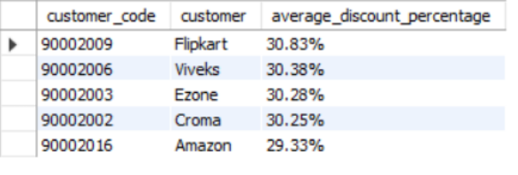
Top 5 customers who received an average high pre_invoice_discount_pct for the fiscal year 2021 and in the Indian market.
Power BI Desktop
select a.customer_code , b.customer , CONCAT(ROUND(avg(pre_invoice_discount_pct)* 100,2),'%') as average_discount_percentage
from fact_pre_invoice_deductions as a
inner join dim_customer as b
on a.customer_code = b.customer_code
where market = "India" and fiscal_year = "2021" group by customer , customer_code
order by avg(pre_invoice_discount_pct) desc
limit 5

Slide 14

Conversion from Output to Visuals
Power BI Desktop
Average discount %age by Customer
30.83
30.38 30.28 30.25
29.33
Flipkart
Viveks
Ezone
Croma
Amazon
Key Insights
The top 5 customers with the highest average pre-invoice discount percentages in the Indian market for FY 2021 are dominated by major e-commerce players, including Flipkart, Amazon, and Croma. This indicates a strategic focus on offering competitive pricing and promotional deals to drive sales in the highly competitive online retail space.
Traditional electronics retailers such as Viveks and Ezone also feature among the top customers with high average discount percentages. This suggests the prevalence of discount-driven strategies within brick-and-mortar retail chains to attract customers and remain competitive in the market.
The presence of multiple players offering high average discount percentages underscores the intense competition in the Indian consumer electronics market. Companies resort to aggressive pricing strategies and promotional activities to gain market share and maintain customer loyalty.

Slide 15

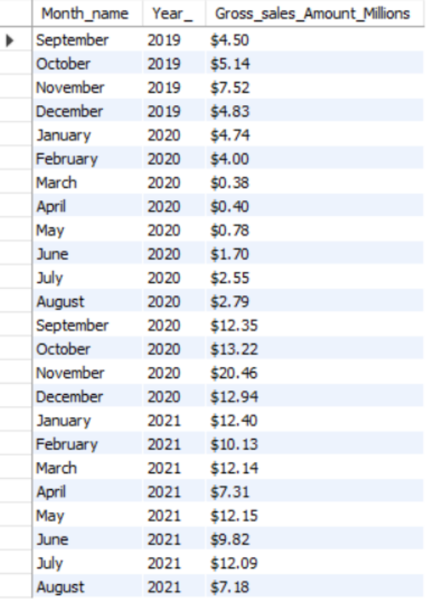
Gross sales amount for the customer “Atliq Exclusive” for each month
Power BI Desktop
select Monthname(date) as Month_name, year(date) as Year_,
concat('$',
Round(sum(a.sold_quantity*b.gross_price)/1000000,2)) as Gross_sales_Amount_Millions
from fact_sales_monthly as a
inner join fact_gross_price as b
on b.product_code = a.product_code and b.fiscal_year = a.fiscal_year inner join dim_customer as c
on c.customer_code = a.customer_code
where c.customer = 'Atliq Exclusive' group by Month_name, year_
order by year_

Slide 16
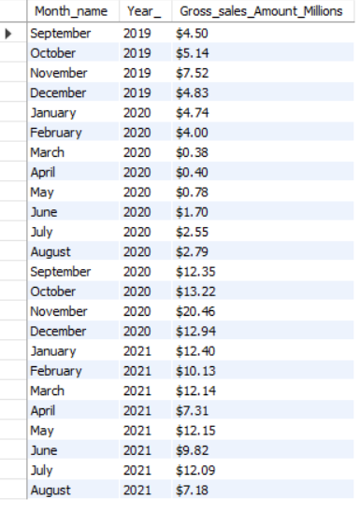
Conversion from Output to Visuals
Power BI Desktop
Gross sales by months and year (in Millions)
$20.46
_{$12.35} $13.22
$12.94 _{$12.4}
$12.14
$12.15
$12.09
$10.13
$9.82
$7.52
$7.31
$7.18
$4.5
$5.14
$4.83 $4.74
$4
$0.78
$1.7
$2.55 $2.79
$0.38 $0.4
2019 2019 2019 2019 2020 2020 2020 2020 2020 2020 2020 2020 2020 2020 2020 2020 2021 2021 2021 2021 2021 2021
Sep… Oct… Nov… Dec… Jan… Febr… Mar… April May June July Aug… Sep… Oct… Nov… Dec… Jan… Febr… Mar… April May June
2021 2021
July Aug…
Key Insights
The analysis provides a comprehensive overview of the gross sales amount for the customer "Atliq Exclusive" across different months spanning multiple years. Sales figures fluctuate significantly from month to month, reflecting seasonal variations, promotional activities, and market dynamics.
Months such as March and April 2020 exhibit relatively low gross sales amounts, indicating potential challenges or downturns in sales during those periods. These months may warrant further investigation to identify underlying factors affecting sales performance and implement corrective measures.
On the other hand, months like November and December 2020 demonstrate notably high gross sales amounts, suggesting peak sales periods or successful marketing initiatives. Understanding the drivers behind these high-performing months can help replicate success strategies and capitalize on sales opportunities in the future.

Slide 17
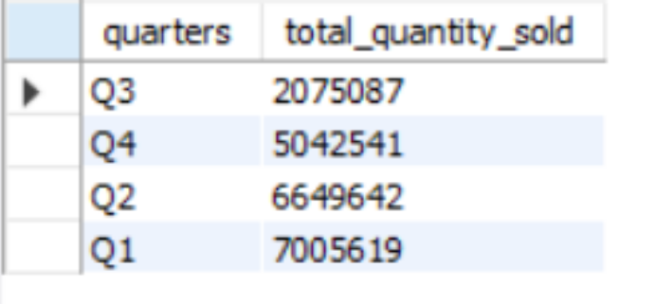
Quarter of 2020, got the maximum total_sold_quantity
Power BI Desktop
select case
when Month(date) in (9,10,11) then 'Q1'
when month(date) in (12,1,2) then 'Q2' when month(date) in (3,4,5) then 'Q3' else 'Q4'
end as quarters,
sum(sold_quantity) as total_quantity_sold from fact_sales_monthly
where fiscal_year = 2020
group by quarters
order by total_quantity_sold

Slide 18

Conversion from Output to Visuals
Power BI Desktop
Total Quantities Sold by Quartes
7.0M
6.6M
5.0M
2.1M
Q1
Q2
Q4
Q3
Key Insights
Quarter 1 (Q1): Recorded the highest total sold quantity of 7,005,619 units during the first quarter of 2020. This indicates robust sales performance in the initial months of the year.
Understanding sales trends by quarter helps Atliq predict demand fluctuations and plan inventory levels accordingly. With the insight that Q1 had the highest sales, Atliq can anticipate similar patterns in future quarters and adjust production and procurement strategies accordingly.
Knowing which quarter experienced the highest sales enables Atliq to allocate resources effectively. For instance, during Q1, when sales are typically high, Atliq can ramp up production and ensure sufficient staffing to meet demand.
tliq can align marketing efforts with high-sales quarters to maximize impact. Promotions, advertising, and product launches can be strategically timed to coincide with periods of high demand, driving sales and revenue growth.

Slide 19

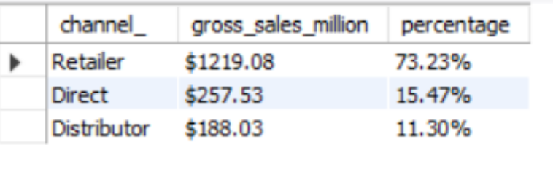
Channel helped to bring more gross sales in the fiscal
year 2021 and
Power BI Desktop
the percentage of contribution
with gross_sales as (
select
c.channel as channel_,
round(sum(a.sold_quantity * b.gross_price)/1000000,2) as gross_sales_million
from fact_sales_monthly as a
left join fact_gross_price as b
on a.product_code = b.product_code and a.fiscal_year = b.fiscal_year
left join dim_customer as c
on a.customer_code = c.customer_code where a.fiscal_year = 2021
group by channel_
)
select channel_,concat('$',gross_sales_million) as gross_sales_million, concat(round(gross_sales_million / sum(gross_sales_million) over()*100,2),'%') as percentage
from gross_sales
order by percentage desc

Slide 20

Conversion from Output to Visuals
Power BI Desktop
Sum of gross_sales_million by channel_
$1,219.08
$257.53
$188.03
Retailer
Direct
Distributor
Key Insights
The retailer channel emerged as the primary contributor to gross sales in fiscal year 2021, accounting for 73.23% of total sales. This suggests that partnerships with retailers have been instrumental in driving sales volume and revenue generation for Atliq Hardwares.
Direct sales, though accounting for a smaller percentage of gross sales at 15.47%, still make a significant contribution. This may indicate the effectiveness of direct marketing efforts or sales initiatives targeted towards specific customer segments or regions.
Distributor sales contributed 11.30% to gross sales, representing another important channel for Atliq Hardwares. Collaborating with distributors allows the company to reach a broader market and leverage their distribution networks to penetrate different regions effectively.

Slide 21
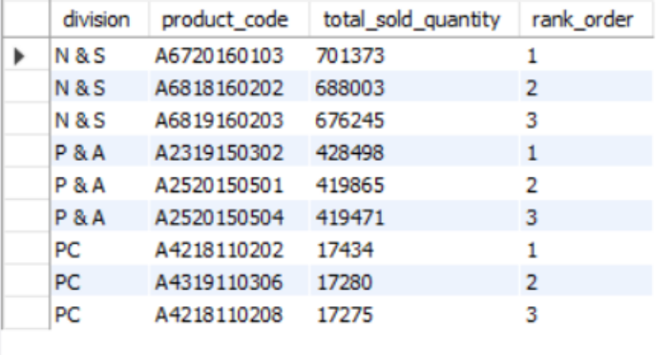
Top 3 products in each division that have a high total_sold_quantity in the fiscal_year 2021
Power BI Desktop
with top_sold_products as (
select b.division as division,
b.product_code as product_code, b.product as product,
sum(a.sold_quantity) as total_sold_quantity
from fact_sales_monthly as a inner join dim_product as b
on a.product_code = b.product_code
where a.fiscal_year = 2021
group by b.division, b.product_code, b.product order by total_sold_quantity desc
),
top_sold_per_division as ( select division, product_code, total_sold_quantity,
dense_rank() over(partition by division order by
total_sold_quantity desc) as rank_order from top_sold_products)
select * from top_sold_per_division where rank_order <=3

Slide 22

Conversion from Output to Visuals
Power BI Desktop
Top 3 Products by Total Sold Quantity by Division
701.37K
688K
676.25K
428.5K
419.87K
419.47K
1 2 3 1 2 3 1 2 3
A67201601… A68181602… A68191602… A23191503… A25201505… A25201505… A42181102… A43191103… A42181102…
Key Insights
The analysis reveals the top-performing products within each division based on total sold quantity in fiscal year 2021. Understanding product performance by division enables Atliq to focus resources and strategic efforts effectively, maximizing revenue and market share.
Identifying the top-selling products helps Atliq prioritize inventory management, production planning, and marketing initiatives. By allocating resources to high- performing products, the company can capitalize on sales opportunities and drive profitability.
Analyzing product performance also provides insights into market trends and consumer preferences. Atliq can leverage this information to adapt product offerings, develop new products, and tailor marketing strategies to meet evolving customer demands and stay ahead of competitors.

Slide 23
Thank You
Power BI Desktop

